Slide 1


Blackhills Diagnostic Resources (BDR) – Company and HLA kits

Slide 2
Contents
1
Who we are
5
Prenatal and newborn screening: BDR solutions
2
Genvinset® product line: HLA kits
6
Real-time PCR and fragment analysis kits
3
BDR HLA kits: portfolio
7
Q&A
4
BDR HLA kits: Clinical context

Slide 3


Who we are

Slide 4



BDR introduction
Our company
Founded in 2012
HLA-disease and genetics
Own software development
Zaragoza - Spain
Manufacturer company
Kits CE-IVDD / IVDR
Worldwide distributor network
EN ISO 13485:2016
CE certifications
IVDD/IVDR expertise
EQCs (EMQN, Instand)

Slide 5
BDR product lines
NGS
New product line 2023
Genvinset®
Real time PCR kits
Bioinformatics
Tools for results intepretation
Adellgene®
Fragment analysis kits

Slide 6
Genvinset® product line: HLA kits

Slide 7

Genvinset® product line: Advantages
1
Reagents ready to use
2
Short and simple work-flow
3
Multiple thermal cyclers validated
4
Multiple sensitivity and diagnostic assays performed
5
Worldwide sells
6
CE-IVDD marked products
7
Results’ interpretation software

Slide 8




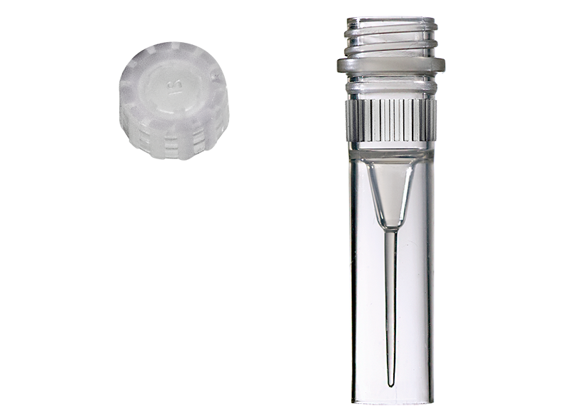
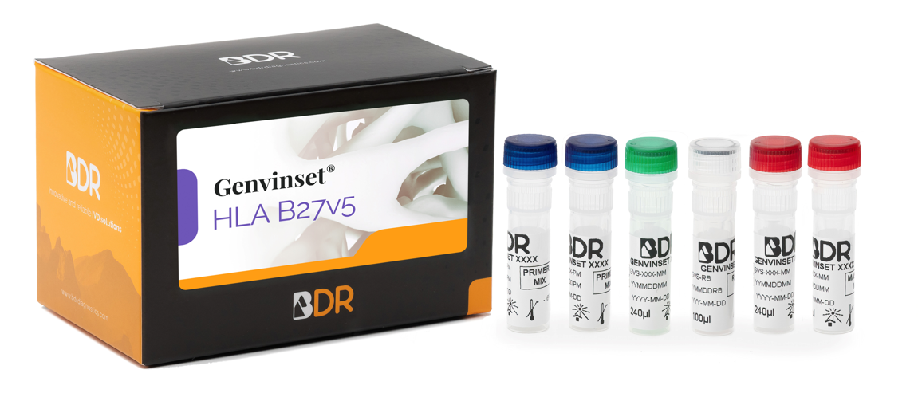
Genvinset® product line: Advantages
1
Reagents ready to use
Controls help indicate the sensitivity and integrity of the experiment
Master Mix
Primer Mix
Positive control (PC)
Reaction Blank (RB)

Slide 9
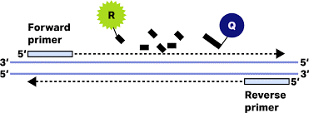




Genvinset® product line: Advantages
2
Short and simple work-flow
+IPC
Extracted DNA
Real-Time PCR
Results

Slide 10
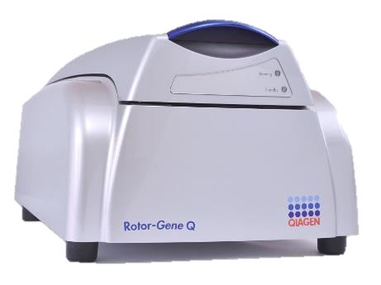
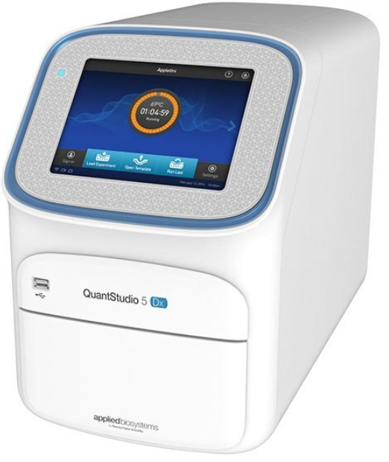
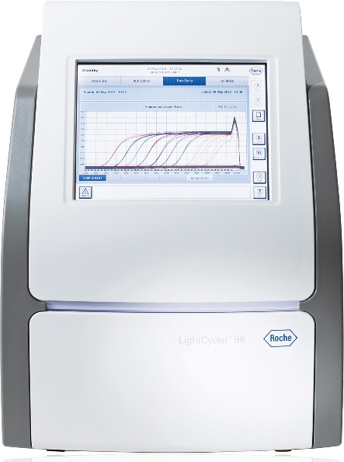
Genvinset® product line: Advantages
Rotor-Gene® Q
3
Multiple thermal cyclers validated
  Applied BiosystemsTM: StepOne™, QuantStudio™ 6 Flex, 7500, QuantStudio™ 5 Dx Real-Time PCR Systems.
  Roche: LightCycler® 96 and LightCycler® 480 System.
  Qiagen®: Rotor-Gene® Q.
  DNA-Technology: DT Lite Real-Time PCR System.
  BioRad: CFX 96 Real-Time PCR.
  Analytik Jena: qTOWER3G
  Bio Molecular Systems: MIC qpCR
QuantStudio™ 5 Real-Time PCR System
LightCycler® 96 System

Slide 11

Genvinset® product line: Advantages
4
Multiple sensitivity and diagnostic assays performed
Large range of input DNA quantity (20-400 ng)
Compatible with the most common extraction methods
12-24 months shelf life
100% repeatability and reproducibility
100% diagnostic sensitivity and specificity

Slide 12


Genvinset® product line: Advantages
5
Worldwide sells
HLA kits sales in Europe: HLA C*06, HLA Diabetes Mellitus T1, HLA DQA105, HLA Narcolepsy, HLA Celiac Plus

Slide 13

Genvinset® product line: Advantages
6
CE-IVDD marked products
CE marking indicates that an IVD device complies with the European In-Vitro Diagnostic Devices Directive (IVDD 98/79/EC) and that the device may be legally commercialized in the EU.

Slide 14
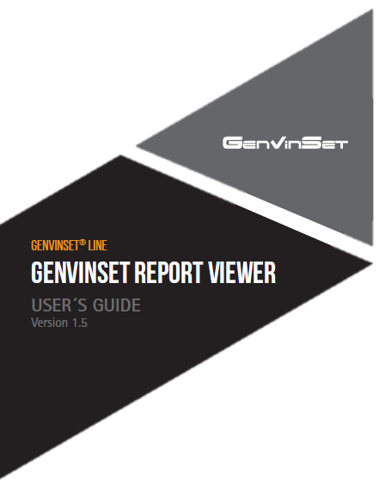

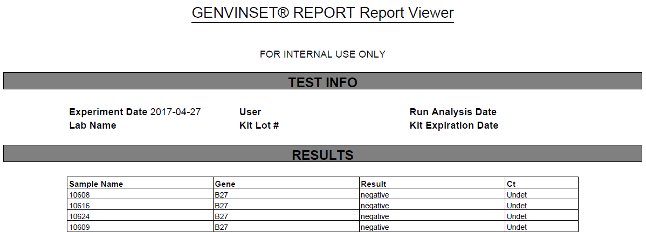
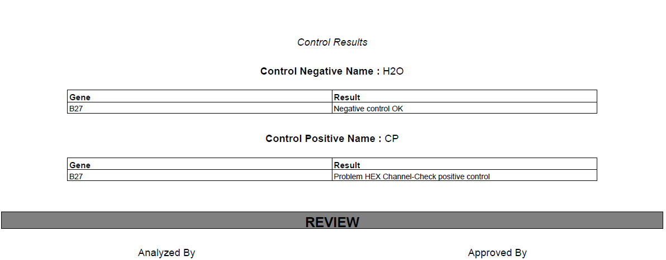


Genvinset® product line: Advantages
7
Results’ interpretation software
Thermal-cycler report
Genvinset® Report Viewer
Final report

Slide 15
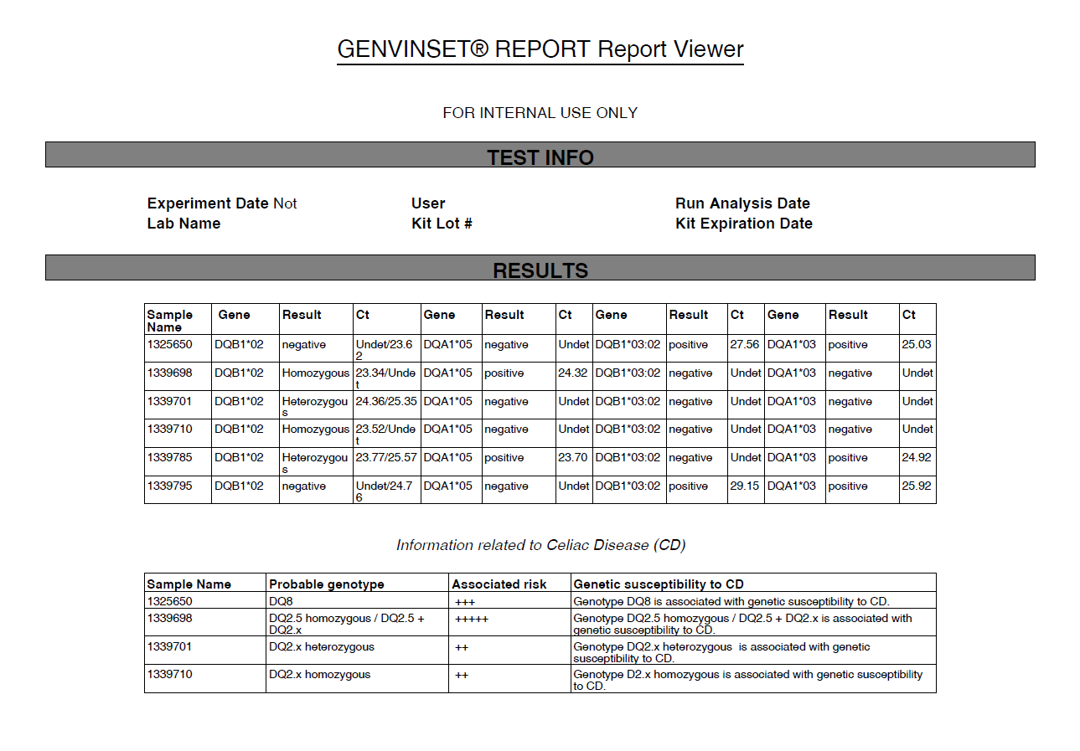
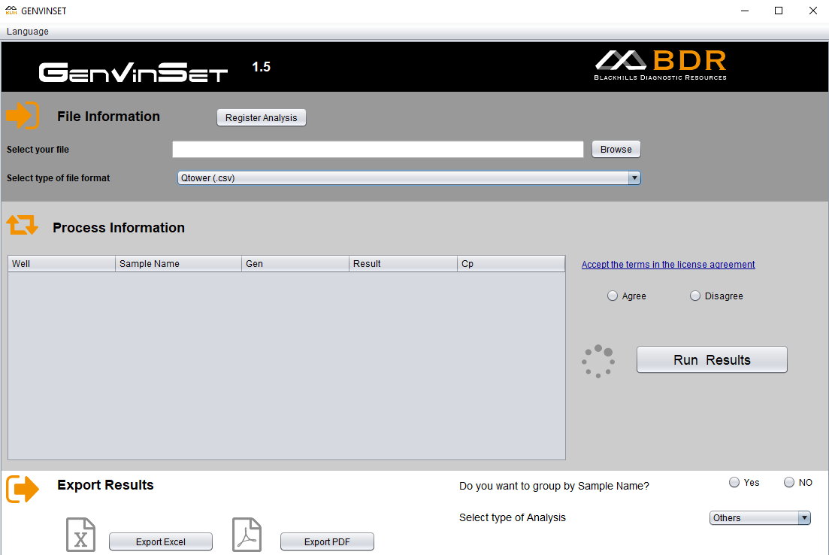
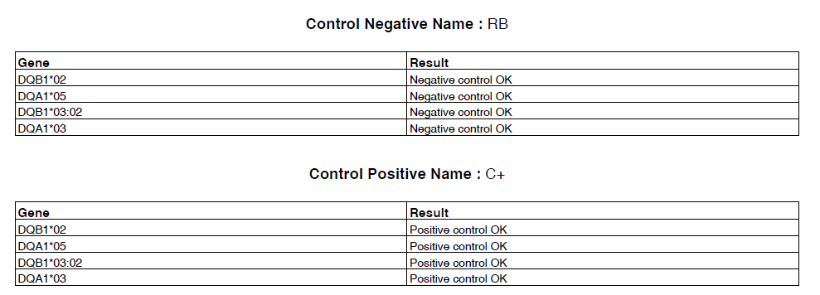
Genvinset® product line: Advantages
7
Results’ interpretation software

Slide 16
BDR HLA kits: portfolio

Slide 17

HLA kits
HLA Diabetes Mellitus T1
HLA Narcolepsy
HLA C06
HLA-DRB1*03/ DRB1*04/ DQB1*02:01/ DQB1*03:02
HLA-DQB1*06:02
HLA-C*06
Diagnosis of Diabetes Mellitus T1 (IDDM)
Diagnosis of Narcolepsy
Diagnosis of Psoriasis
HLA-DR/DQ are considered the main determinants of genetic susceptibility to IDDM
HLA-C*06 allele affects the genetic susceptibility, clinical manifestation, and treatment of psoriasis
>98% patients carry HLA-DQB1*06:02

Slide 18
HLA kits
HLA B27v5
HLA DQA105
HLA A29
HLA-B*27
HLA-DQA1*05
HLA-A*29
Diagnosis of ankylosing spondylitis
Treatments using infliximab / adalimumab
Diagnosis of birdshot retino-choroidopathy
HLA-B*27 alleles are present in up to 90% of patients
HLA-DQA1*05 alleles are associated with a high risk of ADA formation
More than 90% of patients are HLA-A*29 positive

Slide 19
HLA kits
HLA kits
HLA B57v5
HLA Behçet v5
HLA Celiac Plus
HLA-DQB1*02, DQB1*03:02, DQA1*05 and DQA1*03
HLA-B*57
HLA-B5
Prior HIV treatment with Abacavir
Diagnosis of Behçet’s disease
Diagnosis of Celiac Disease (CD)
Abacavir hypersensitivity is strongly associated with the HLA-B*57:01 allele
The HLA-B5 antigen is a risk factor strongly associated with BD
DQ2/DQ8 are strongly associated with CD

Slide 20
BDR HLA kits: Clinical context

Slide 21



HLA Celiac Plus
Genvinset® HLA Celiac Plus
Celiac disease clinical context
Celiac disease(CD) is a malabsorption disorder caused by an abnormal immune reaction to gluten, protein present in cereals like wheat, barley and rye.
A strong predisposition to suffer the disease is associated to HLA-DQ alleles and their combinations, located at the Major Histocompatibility Complex (MHC) class II:
90-95% of patients are carriers of the heterodimer HLA-DQ2
(cis or trans position)
Allelic frequency distribution
((more common in Central and Northern Europe and Mediterranean countries)
BDR kit advantages:
The kit is able to determine the homozygosity or heterozygosity status for the DQB1*02 alleles
Allows the qualitative detection of HLA-DQB1*02, DQB1*03:02, DQA1*05 and DQA1*03 alleles
5-10% of patients are carriers of the heterodimer HLA-DQ8
(mainly in indigenous South American patients)

Slide 22

HLA Celiac Plus
Genvinset® HLA Celiac Plus
Guidelines
Most guidelines suggest excluding HLA-DQ2/DQ8 in CD first-degree relatives and high-risk patients, even if asymptomatic, to avoid periodic monitoring
HLA-DQ2/DQ8 genes are the most important genetic factor in the development of CD
European Society for the study of Coeliac Disease (ECD), 2019
World Gastroenterology Organization (WGO), 2017
Central Research Institute of Gastroenterology, Russia, 2016
National Institute for Health and Care Excellence (NICE), 2015
British Society of Gastroenterology (BSG), 2014
America College of Gastroenterology (ACG), 2013

Slide 23

HLA DQA105 kit
HLA Celiac Plus
Genvinset® HLA Celiac Plus
Celiac Disease clinical context
Genetic testing for Celiac disease is prescribed by the digestive department of the hospital.

Slide 24
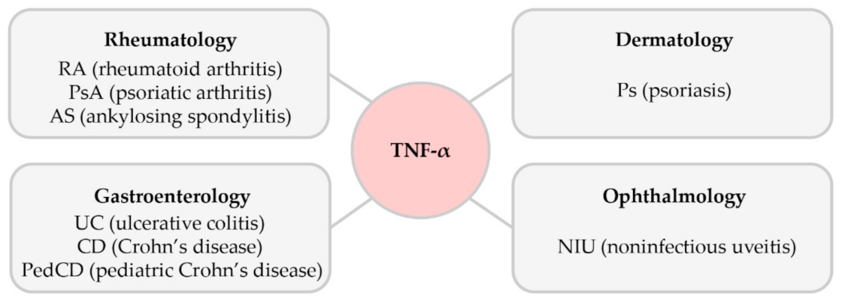

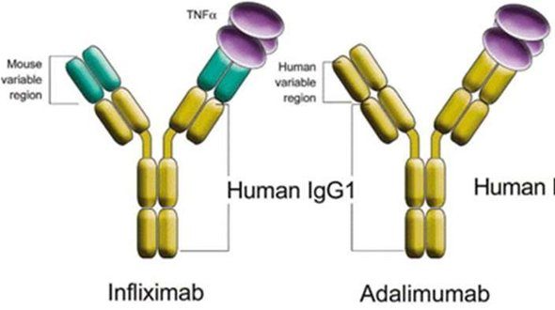
HLA DQA105 kit
Genvinset® HLA DQA105
HLA-DQA1*05 clinical context
Anti-TNF therapies
Anti-TNF therapies were developed because of the role of tumor necrosis factor alpha (TNF) in chronic immune-mediated diseases

Slide 25




HLA DQA105 kit
HLA-DQA1*05 clinical context
Prolonged use of these anti-TNF antibodies
Formation of anti-drug antibodies (ADA)
Identify subjects at higher risk
Decrease the efficacy of the treatment

Slide 26

HLA DQA105 kit
HLA-DQA1*05 clinical context
HLA-DQA1*05 alleles were associated with a high risk of ADA formation and loss of treatment response
The screening of the HLA-DQA1*05 allele may be a useful clinical tool that could predict ADA risk and guide the clinical approach of anti-TNF therapies
BDR kit:
The kit allows the qualitative detection of the HLA-DQA1*05 allele in gDNA

Slide 27
HLA DQA105 kit
HLA-DQA1*05 clinical context
HLA-DQA1*05 screening is prescribed by the digestive or rheumatology department of the hospital, where anti-TNF therapies are administered (Infliximab / Adalimumab drugs)

Slide 28
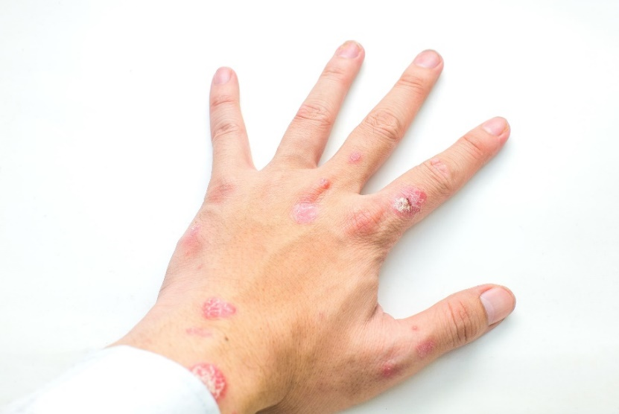
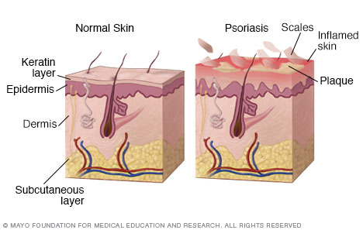
HLA C06 kit
Genvinset® HLA C06
Psoriasis clinical context
Chronic, inflammatory skin disease caused by an autoimmune response.
Symptoms: the appearance of patches of abnormal skin, epidermal hyperplasia, cell inflammatory infiltration and vascular remodelling.
HLA-C*06 has been identified as a major psoriasis susceptibility genetic polymorphism

Slide 29
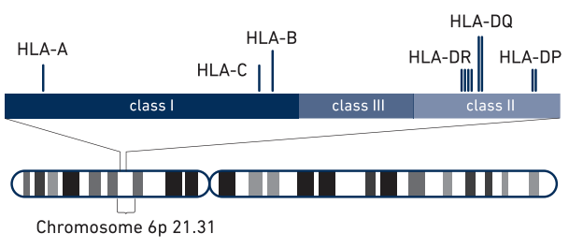
HLA C06 kit
Genvinset® HLA C06
Psoriasis clinical context
HLA-C*06 allele affects different aspects of psoriasis, from genetic susceptibility to clinical manifestation, comorbidity and treatment efficacy
HLA-C*06 positive patients:
More severe and unstable form of disease
Better treatment response (faster and greater) to both conventional and biological agents
[HLA region] Extracted from: https://community.10xgenomics.com
BDR kit:
The kit allows the determination of the HLA-C*06 group of alleles in gDNA

Slide 30
HLA C06
kit
Psoriasis clinical context
HLA-c*06 screening is prescribed by the dermathology or rheumatology department of the hospital

Slide 31

HLA Narcolepsy
kit
Genvinset® HLA Narcolepsy
Narcolepsy clinical context
Neurodegenerative disease, characterized by an excessive daytime sleepiness and sudden sleep attacks.
Symptoms: Excessive daytime sleepiness, cataplexy, sleep paralysis, night-time sleep fragmentation, hallucinations
Presence of HLA-DQB1*06:02 allele in almost all narcoleptic patients (>90%) but also expressed in some non-narcoleptic individuals (5-38%). → high negative predictive value
HLA-DQB1*06:02 → genetic marker which confers the strongest predisposition to Narcolepsy

Slide 32
HLA Narcolepsy
kit
Narcolepsy clinical context
HLA-DQB1*06:02 screening is prescribed by the neurology department of the hospital
BDR kit:
The kit allows the determination of the HLA-DQB1*06:02 group of alleles in gDNA

Slide 33
Prenatal and newborn screening: BDR solutions

Slide 34
BDR RT-PCR kits

Slide 35

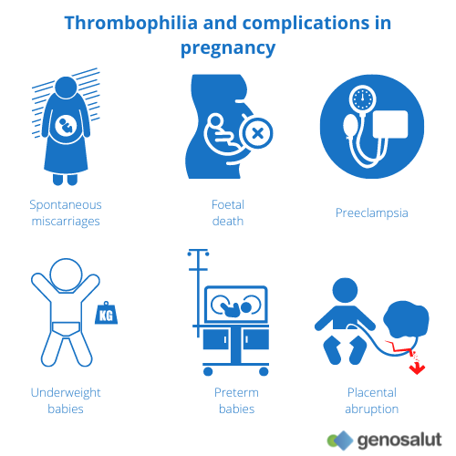
RT-PCR kits
Genvinset® Thrombophilia
Thrombophilia consists in the predisposition to form blood clots, caused by an underlying hypercoagulation state attributable to inherited or acquired disorders of blood coagulation or fibrinolysis.
Thrombophilia is a common cause of RPL and may be seen in 40–50% of cases.
The association between thrombophilia and recurrent pregnancy loss (RPL) has become an undisputed fact.

Slide 36
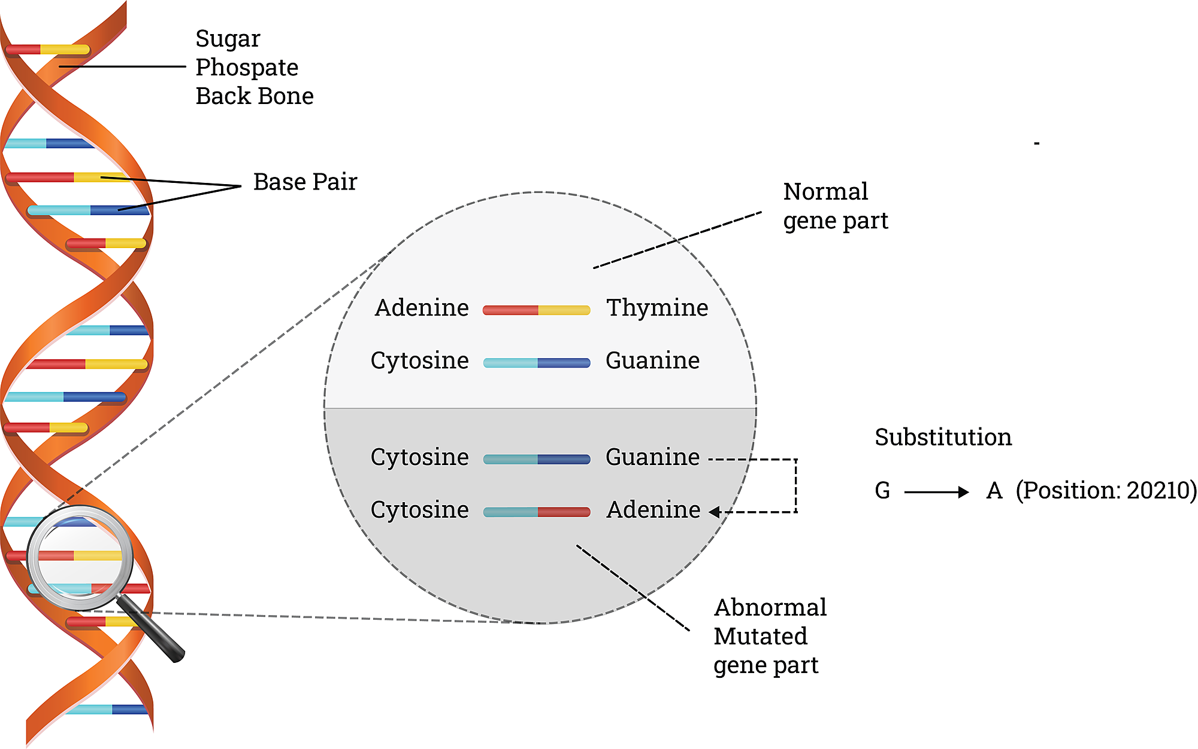
https://www.tandfonline.com/doi/full/10.1080/19396368.2018.1456576
RT-PCR kits
Genvinset® Thrombophilia
Thrombophilic disorders were demonstrated to be risk factors in a majority of women with recurrent pregnancy loss (RPL) and infertility.
It has been suggested in several studies the importance of evaluating various polymorphisms (FXIII Val34Leu, MTHFR 677C/T, especially PAI-1 4G⁄5G, FV A506G (Leiden), FV A5279G, BF 455G⁄A, and MTHFR 1298A⁄C polymorphisms, especially the presence of both MTHFR 677C⁄T and 1298A⁄C variants) in women with RPL.

Slide 37
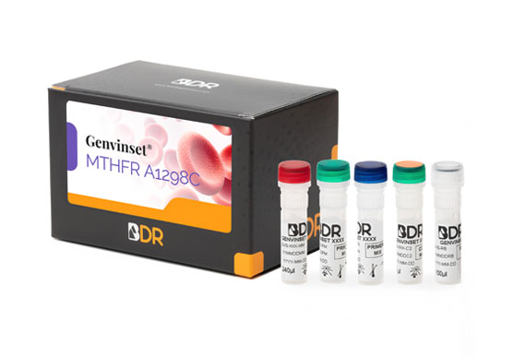
RT-PCR kits
Genvinset® Thrombophilia
Genvinset® PAI-1 4G/5G allows the detection of the 4G/5G deletion in the promoter region of the Plasminogen activator inhibitor 1 (SERPINE1) gene
Genvinset® Thrombophilia kits
Genvinset® Factor II G20210A allows the detection of the G20210A mutation in the prothrombin (FII) gene
PAI-1 4G/5G
FII G20210A and FV G1691A
MTHFR C677T / A1298C
Genvinset® Factor V G1691A allows the detection of the G1691A mutation in the factor V (FV) gene
Genvinset® MTHFR C677T allows the detection of the C677T polymorphism in the Methylene tetrahydrofolate reductase (MTHFR) gene
All mutations associated with high thombophilia risk
Genvinset® MTHFR A1298C allows the detection of the A1298C polymorphism in the Methylene tetrahydrofolate reductase (MTHFR) gene

Slide 38
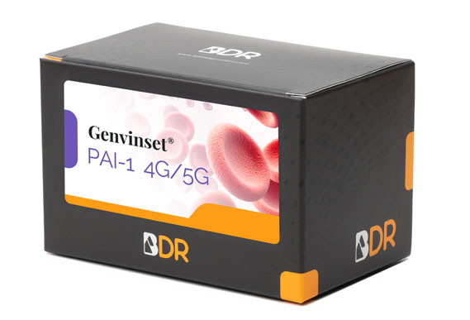
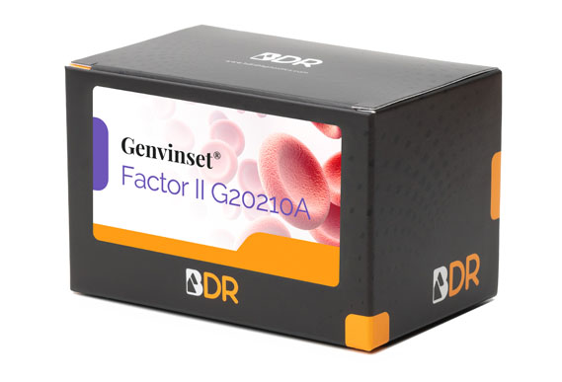
RT-PCR kits
Genvinset® Thrombophilia
BDR kit advantages:
The kit allows the qualitative detection of mutations associated with thrombophilia risk
Reagents in both multiplex and singleplex formats to fit users’ needs
The kit includes a positive wild-type and mutant controls

Slide 39

RT-PCR kits
The ultimate public health aim of genetic screening is prevention.
This can be achieved through primary or secondary methods such as pre-conceptional or antenatal screening.
Tertiary prevention by neonatal screening is also an option where there is direct evidence for a substantial improvement in prognosis.
Phenylketonuria (PKU), congenital hypothyroidism, galactosemia, sickle cell disease, maple syrup urine disease, homocystinuria, biotinidase deficiency, congenital adrenal hyperplasia…
The most recent additions to screening programs (screening for cystic fibrosis, severe combined immunodeficiency and spinal muscular atrophy) were assisted by the introduction of molecular technologies

Slide 40
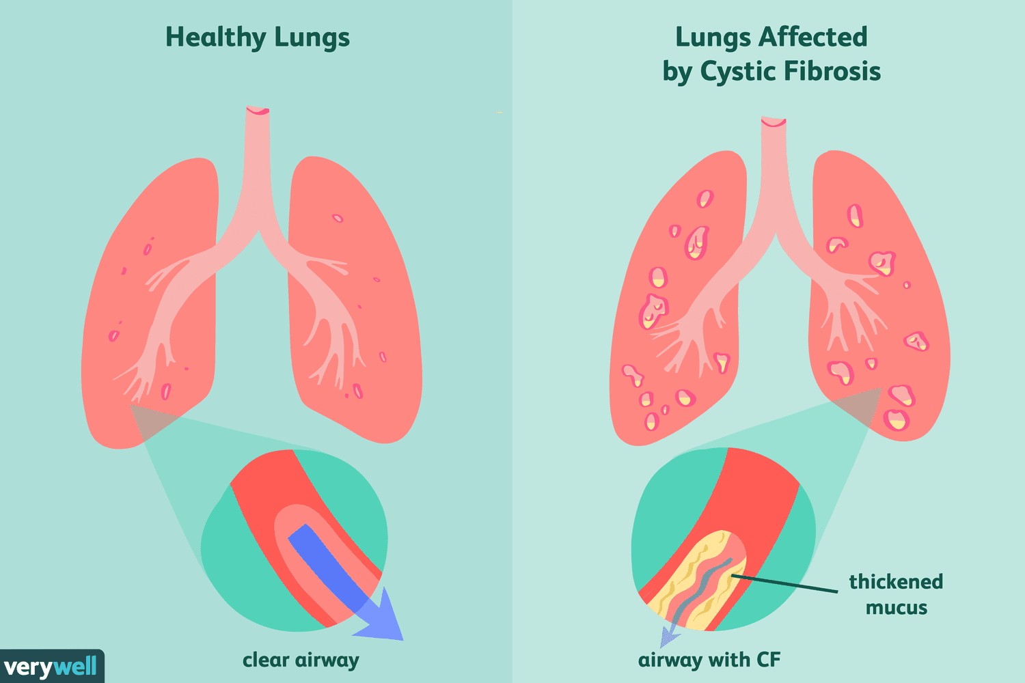
RT-PCR kits
Genvinset® deltaF508
Cystic fibrosis is an autosomal recessive genetic disorder that affects several different organs. Patients with CF generally suffer from obstructive lung disease with chronic bacterial infection, pancreatic enzyme insufficiency, and high salt content in their sweat.
CF is caused by mutations in the cystic fibrosis transmembrane conductance regulator gene that encodes the CFTR protein, which regulates water and ion transport and maintains epithelial surface hydration.

Slide 41
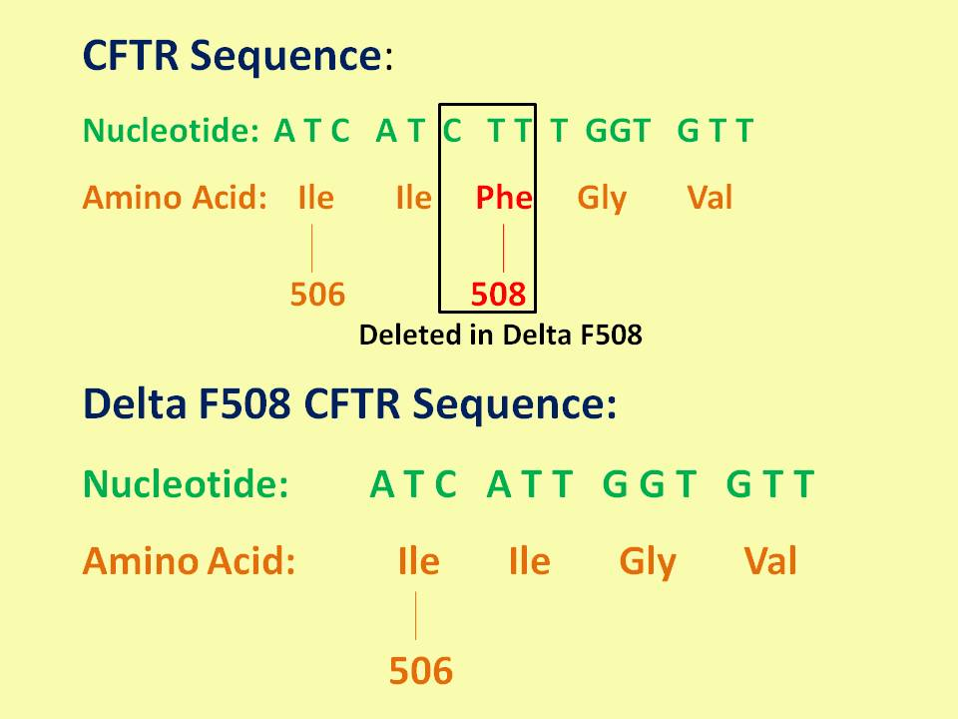
RT-PCR kits
Genvinset® deltaF508
Although deletion of F508 (F508del or ΔF508) constitutes between 50-90% of the CF cases, more than 2100 variants of the CFTR gene have been identified
BDR kit:
The kit allows the qualitative detection of wild-type and/or F508del alleles in the Cystic Fibrosis Transmembrane Conductance Regulator (CFTR) gene in gDNA

Slide 42
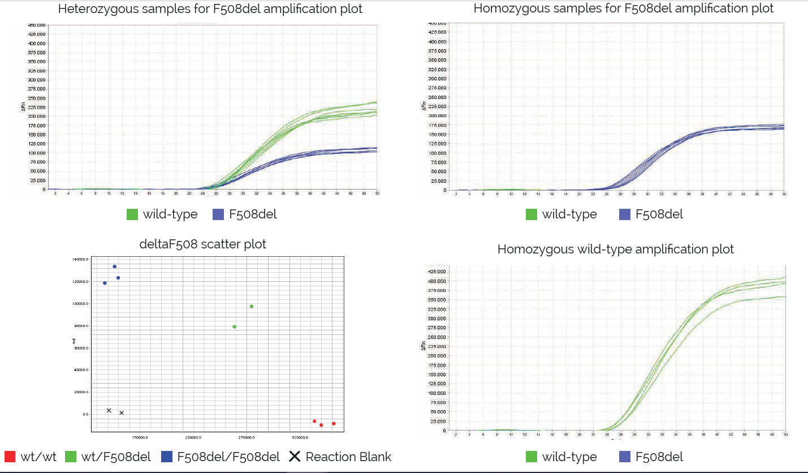
RT-PCR kits
Genvinset® deltaF508 kit

Slide 43
BDR fragment analysis kits

Slide 44

Fragment analysis kits
Adellgene® Clinical Context
Screening during pregnancy has been offered as part of standard prenatal care appointments or when seeing a genetic counsellor. In addition, several studies provide insight into carrier screening as a clinical service that women can take up before pregnancy or during pregnancy.
Knowledge of carrier status could encourage lifestyle changes and preventive measures likely to reduce the risk of medical problems in disorders such as Fragile X Syndrome or Myotonic Dystrophy.

Slide 45

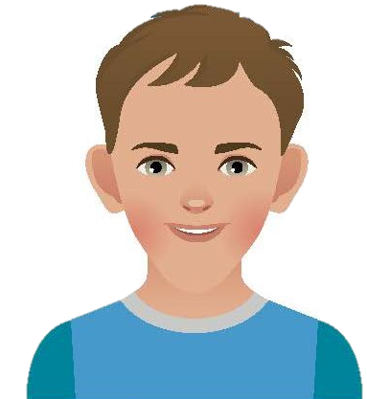
Fragment analysis kits
Adellgene® Fragile X
Narrow face
Articular flexibility
Genetic disease that causes hereditary mental retardation.
Difficulties with the language
Intellectual impairment
1 in every 8,000 females
1 in every 4,000 males
Macrocephaly and big ears
Equal distribution among different populations and ethnic groups.
Behavioural disturbance

Slide 46
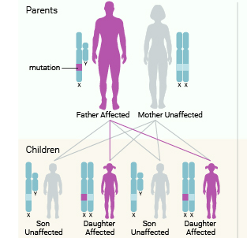
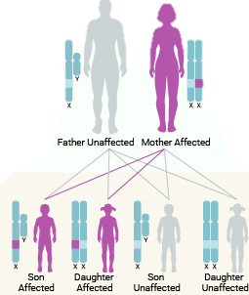
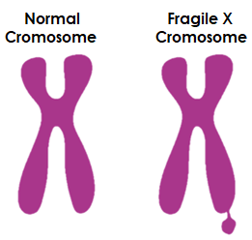
Fragment analysis kits
Adellgene® Fragile X
Genetics
Mutation in the FMR1 gene (Fragile X Mental Retardation 1)
X-Linked dominant
Credit: U.S. National Library of Medicine

Slide 47
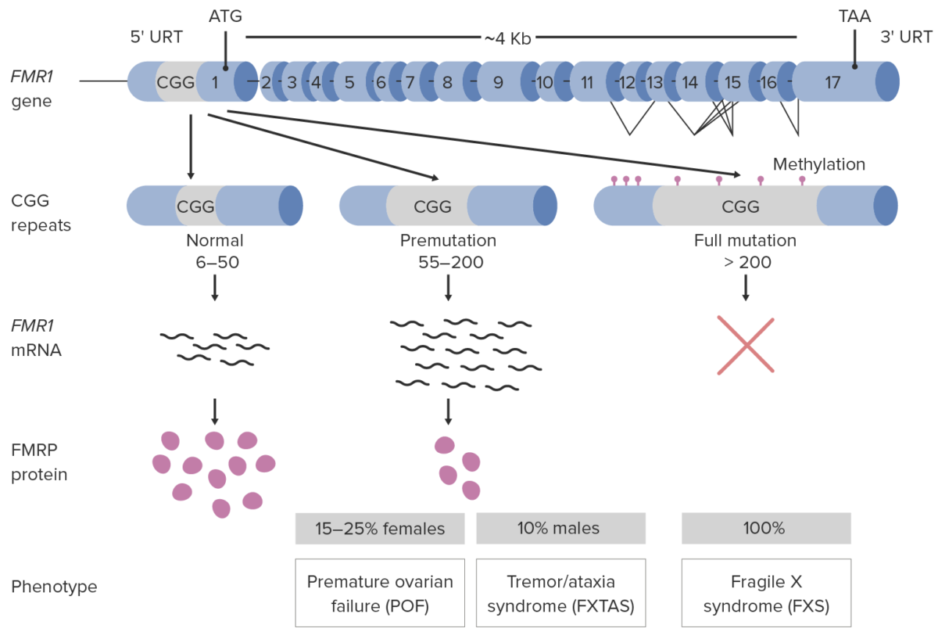

Fragment analysis kits
Adellgene® Fragile X
Genotypic classification
Mutation in the FMR1 gene
  CGG triplet expansion
  Aberrant methylation in the promoting region of the gene
Inactivation of the FMR1 gene
Lack of FMRP protein
(Fragile Mental Retardation Protein)
Pathophysiology of fragile X syndrome. Image by Lecturio

Slide 48
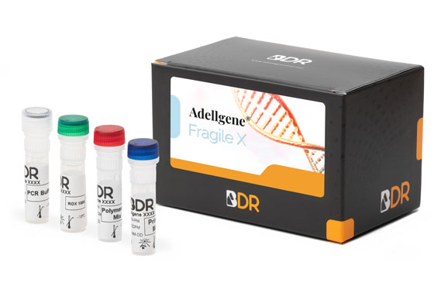
Fragment analysis kits
Adellgene® Fragile X
Adellgene® Fragile X is a diagnostic kit that allows the quantitative determination of CGG triplet repeats (cytosine-guanine-guanine) in the 5’ untranslated region of the fragile X mental retardation (FMR1) gene.
BDR kit advantages:
The kit is based on a Triplet Repeat Primed PCR (TP-PCR) followed by capillary electrophoresis (CE)
The kit allows the quantification of up to 200 CGG repeats and detection of >200 repeats.
It allows the determination of all kinds of alleles: wild-type, premutation and mutant alleles
The kit includes the size marker for CE
TRC software to calculate the number of repeats

Slide 49
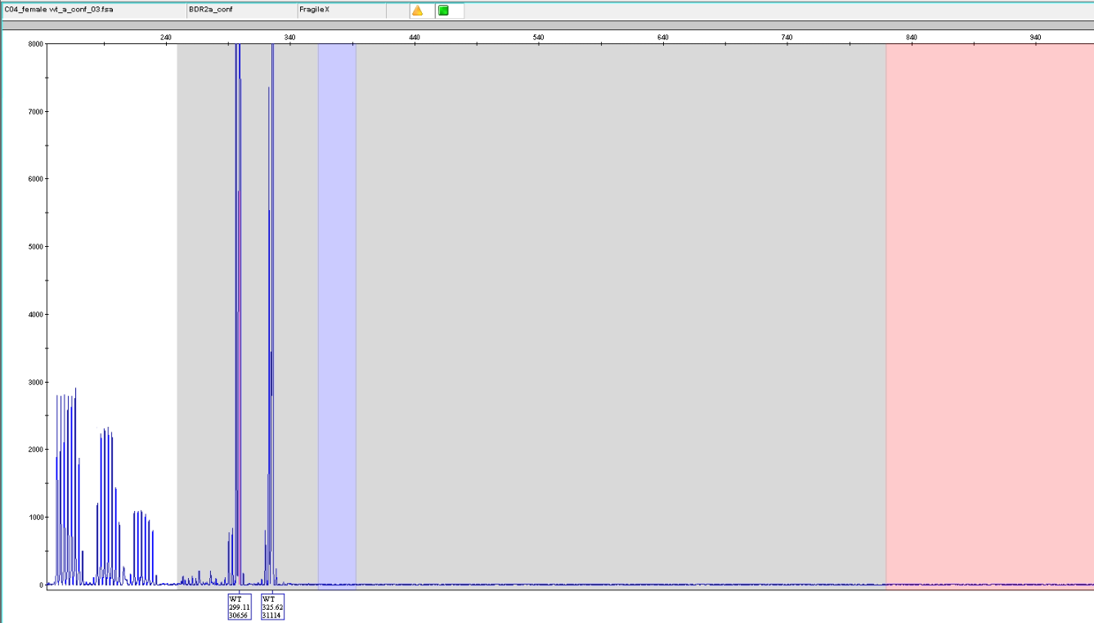
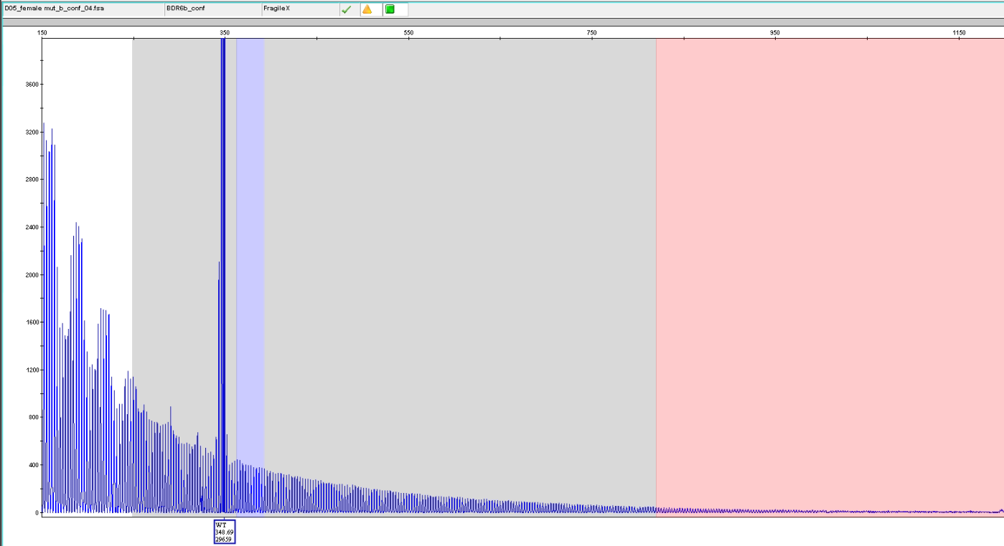
Fragment analysis kits
Adellgene® Fragile X
Healthy heterozygous
Healthy / full mutation

Slide 50

Fragment analysis kits
Adellgene® Myotonic Dystrophy
Miscarriage, maternal disease progression during pregnancy, and other pregnancy-related complications may occur in Myotonic Dystrophy (DM) patients. Women with DM should be counselled on these potential risks prior to considering pregnancy.
The possible complications and outcomes associated with pregnancy in DM vary from a higher miscarriage rate, to elevated rates of preeclampsia and peripartum haemorrhage.

Slide 51
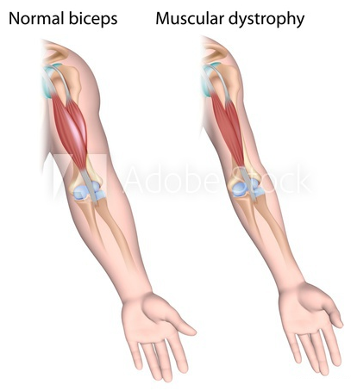
Fragment analysis kits
Adellgene® Myotonic Dystrophy
Digestive disorders
Myotonic Dystrophy Type 1 or Steinert’s Myotonic Dystrophy is a multisystemic disorder characterized by myotomy and multiorgan damage.
Adult mild type: almost no symptoms until adulthood (40 years approx), decreases patient’s lifespan
Children’s type: Congenital form, frequently lethal
Cognitive disorders
Atrophy and muscle weakness
Breathing disorders
Cardio-circulatory disorders
Cataracts

Slide 52
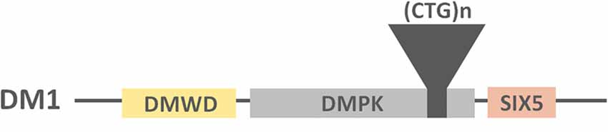
Fragment analysis kits
Adellgene® Myotonic Dystrophy
Mutation in the DMPK gene (Myotonic dystrophy kinase protein)
Accumulation of the aberrant transcript of DMPK in the myocytes and neurons
Anomalous union to nuclear proteins
Formation of aggregates
Alteration of the expression of genes involved in neuronal and muscle-differentiation
  CTG triplets expansion in the 3’ untranslated region of the gene

Slide 53
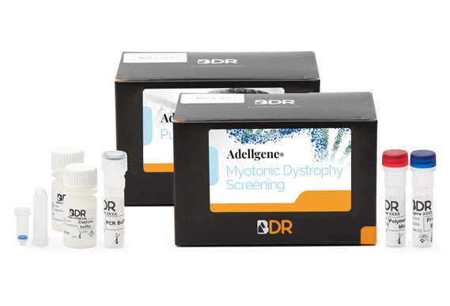
Adellgene® Myotonic Dystrophy
Adellgene® Myotonic Dystrophy Screening / Confirmatory kit allows the detection of the number of CTG repeats in the 3´UTR region of the DMPK gene. It aims to aid clinical diagnosis associated with clinical findings in myotonic dystrophy type 1 (DM1) that span from mild to severe symptoms.
BDR kit advantages:
The kit is based on a PCR / Triplet Repeat Primed PCR (TP-PCR) followed by capillary electrophoresis (CE)
The kit allows the quantification of up to 150 CGG repeats
It allows the determination of all kinds of alleles: wild-type, premutation and mutant alleles
BDR software to calculate the number of repeats

Slide 54
Q&A

Slide 55
Blackhills Diagnostic Resources (BDR) – Company and HLA kits

Slide 56
Thank you for your attention!

